Slide 1
User Interaction with Forms

Slide 2
HTML Forms
The FORM element is used to create a data input form.
A document can have several forms, but the forms should not be embedded.
The FORM element has attributes:
NAME
ACTION
METHOD

Slide 3
<Form></Form>
Any standard HTML element (except another <form>) can be contained within <form>
Attributes: NAME = “name” and ACTION =“url”
NAME: Name the form (For tasks related to user input data processing )
ACTION: The URL of the program that will process the data when the form is submitted .
METHOD: GET or POST

Slide 4
Form Method
Specifies the way in which the data from the user are encoded.
GET
POST
The default METHOD is GET, although the POST method is preferred.
POST: program receives the encoded form input in its standard input stream.

Slide 5
Form Action
Specifies the destination URL to which the form should be submitted, once it has been completed by the user.
If no URL is specified, the URL of the current document containing the form is used.

Slide 6
Form Tag
<Form Action=“/controller/action” Method=“post”>
(all form elements inside)
</Form>

Slide 7
HTML <input> Type
text
password
submit
reset
checkbox
radio
hidden
file

Slide 8
ASP.NET Object Model
Client
Server
Request Object
Server
Object
Response Object
Application
Object
Session
Object

Slide 9
ASP.NET Request Object
When a page is requested, much information is passed along with the request, such as the URL, queryString, and data from a form
The request object allows you to get the information passed along with the request
It is created from the System.Web.HttpRequest class

Slide 10
Request Object Collections
QueryString
http://my.com/Target?CustID=C1&CustName=Chao
cid = Request.queryString[“CustID”]
cName=Request.queryString[“CustName”]
Form
A form with two input text: CustID, CustName
cid = Request.Form[“CustID”]
cName=Request.Form[“CustName”]
Cookies

Slide 11
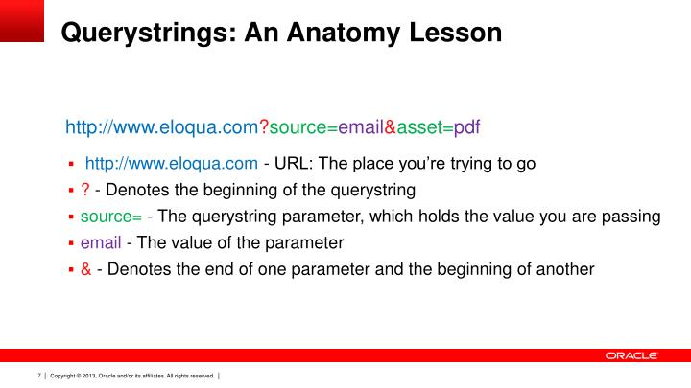
Query String

Slide 12
Request.Form Collection
The Form collection retrieves the values of form elements posted to the HTTP request body, with a form using the POST method
Syntax: Request.Form[“element”]

Slide 13
Request.QueryString Collection
The QueryString collection retrieves the values of the variables in the HTTP query string
The HTTP query string is specified by the values following the question mark (?)
<A HREF=“localhost?string=this is a sample">string sample</A>
Syntax: Request.QueryString[“variable”]

